Slide 1
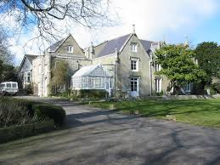
Leeson House
17-18 March 2025

Slide 2
Leeson House – main details
Leave school at 9.30 am on Monday 17th
Come to school in own clothes, with bags (children have to be able to carry their own bags).
First day packed lunch provided by home/school (if paid for a hot meal).
Return to school Tuesday 18th for about 2.15pm. You may collect your child then. Normal pick-up time is of course fine if early pick up is not possible for you.
Please ensure your emergency contact details are up to date with school.
All medicines and money to be given to staff before departure – clearly named.
Any medications should be accompanied with a signed permission form including timings and dosages. We are unable to administer medicines without this.
Emergency contact details are the school office.
There will be one other school there – another year 5 group.
Staff going: Miss Lyndley, Mrs Romano and Mrs Pattinson-Smith
Anything the children bring is their own responsibility. They are not allowed to bring any electronic devices.

Slide 3
Main details continued - Food
On the first day a packed lunch should be provided from home (no fizzy drinks, energy drinks, caffeine or sweets), or from school if your child has ordered a hot dinner.
Dinner in the evening will be at 5.30 in the dining hall. Each school is designated its own area of the dining hall. Any allergies will be taken into account. We sent a list of allergies to Leeson so they have that information.
Breakfast will be at 8.15 and eaten in the dining room.
Packed lunch will be collected from the main hall where there is also somewhere for the children to fill their water bottles.

Slide 4
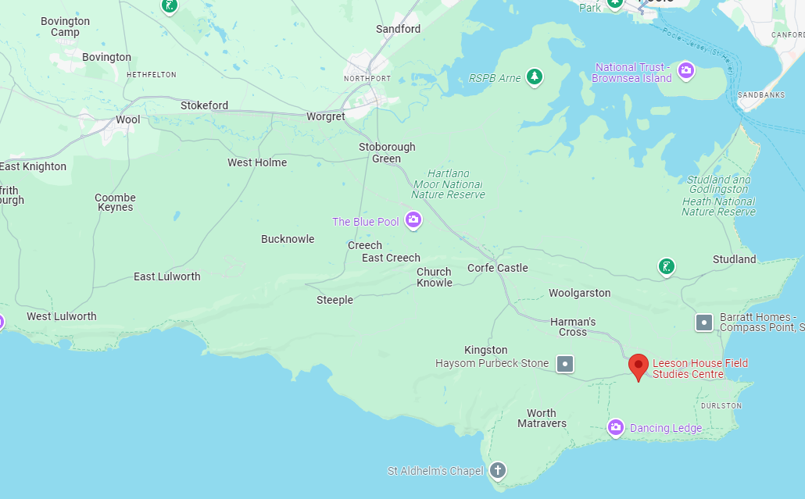
Location
Leeson House is a field studies centre in the village of Langton Matravers, near Swanage.
We will travel there and back in Leeson House mini buses. It is about 25-30 minutes from school.
https://leesonhouse.com

Slide 5
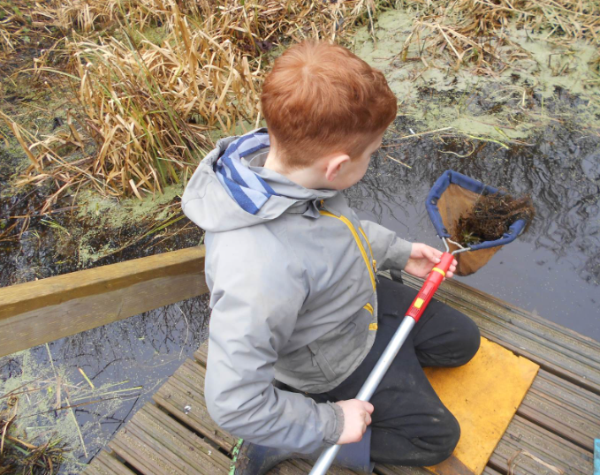
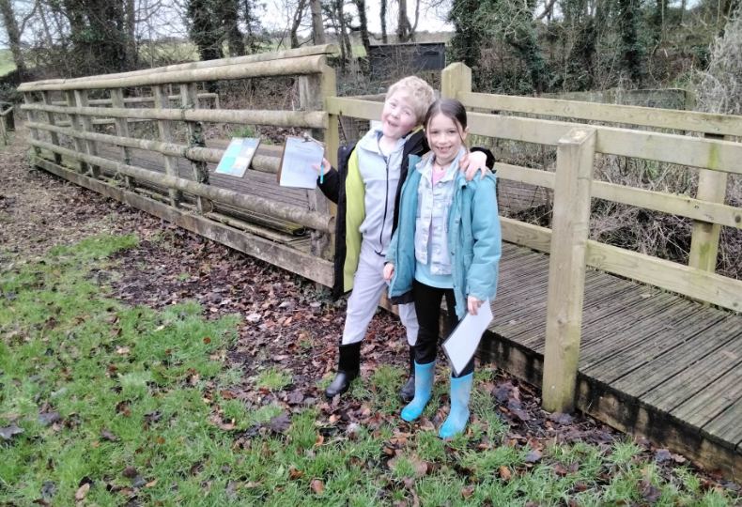
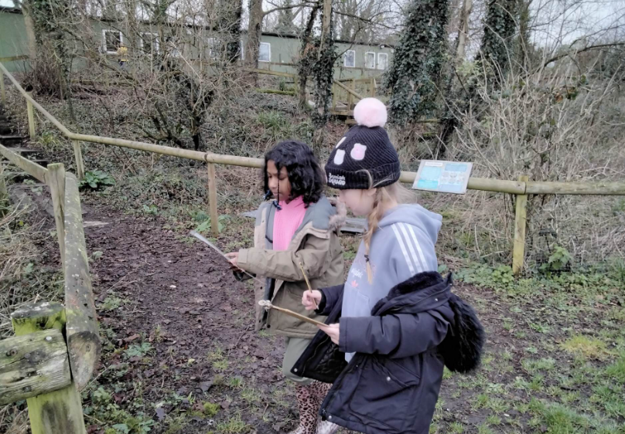
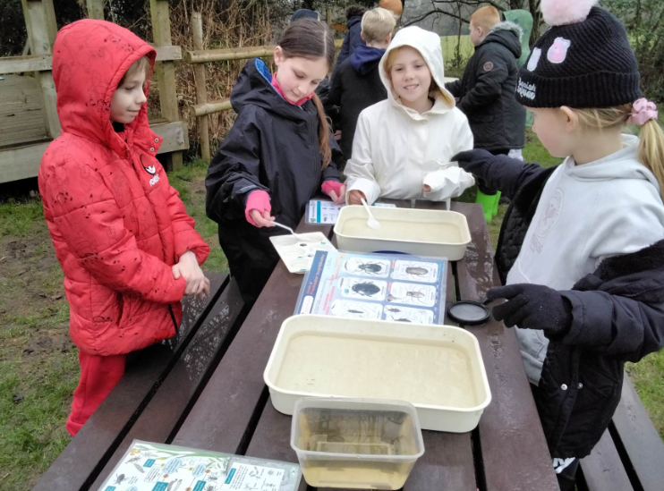
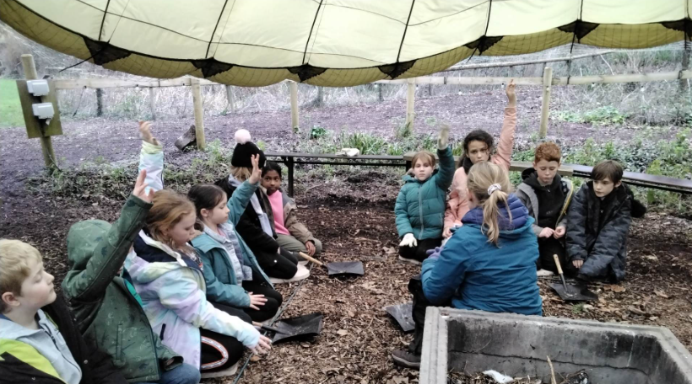
Virtual tour: https://my.matterport.com/show/?m=GUC1SRdQNC2

Slide 6
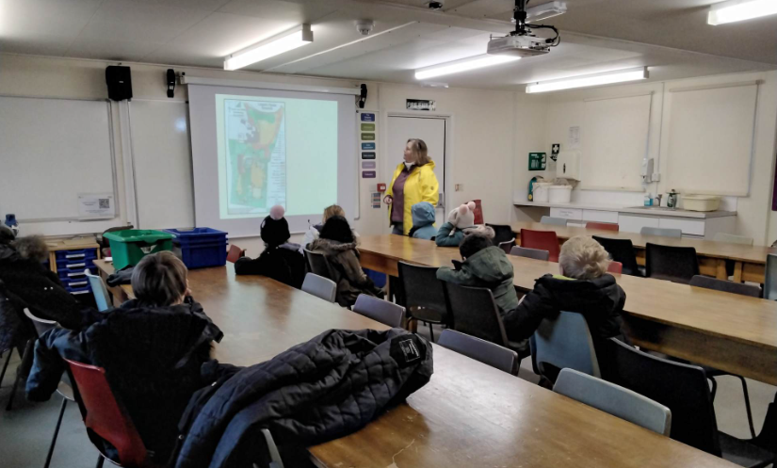
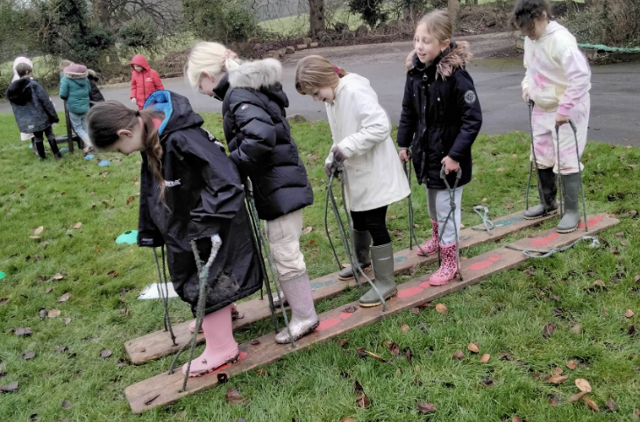
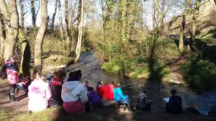
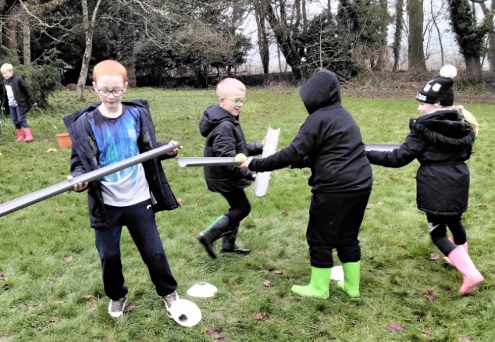
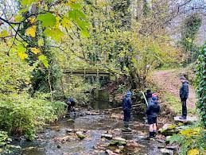

Slide 7
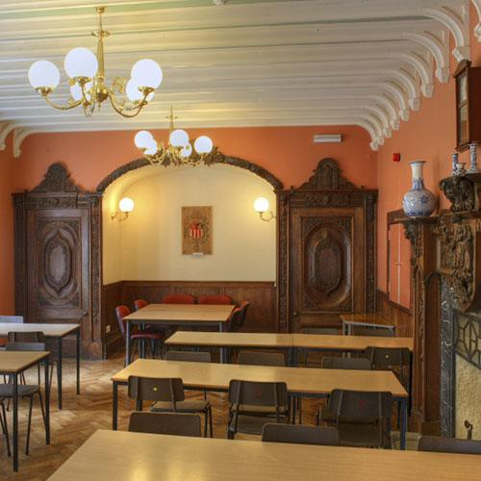
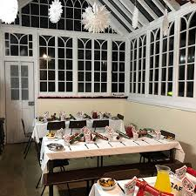
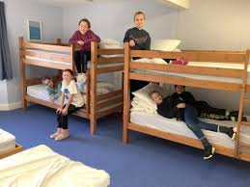
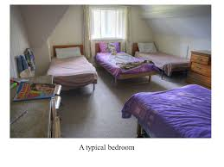

Slide 8
 | Daytime | Evening
Monday | Leave school 9.30 Arrive Leeson House about 10am, put bags in hall. Introductions, including fire talk. Pond study Team games Environmental art Pack lunch brought from home / school in between activities. | Dinner at 5.30 Night orienteering Hot chocolate
Tuesday | 8.15am breakfast Tidy, pack and load bags onto minibuses. Off to river site – either Swanbrook, Corfe or River Piddle depending on weather and depth of water. Activities such as river measurements, sketching, river animals. Picnic lunch provided by Leeson House. Then return to school. We will leave the river site at 1.45pm. | Sleep

Slide 9
The children will be expected to adhere to the school rules of ready, respectful and safe at all times – day and night. If this is not adhered to, we may need to ring you and a decision may have to be made for you to come and collect your child.
Leeson House Code of Conduct for Primary School Visiting Groups:
Our Code of Behaviour is based on mutual respect while safely having fun trying new learning experiences.
We reserve the right to ask a school to leave if any pupil is deemed overly disruptive, dangerous or affects the general enjoyment of other visitors.
Behaviour deemed inappropriate, but not limited to:
• Bullying, to include but not restricted to; physical assault, teasing, making threats, name calling,
• Leaving the site unless accompanied by a member of school staff
• Threatening behaviour, offensive language to other guests or Leeson House staff
• Entering the accommodation area used by the opposite sex or used by other school groups
• Wilfully leaving the main house without good reason after lights out
• Theft, vandalism, deliberate damage to property
• Accessing and/or publishing content on the internet/social media (the children should not have any electronics with them so this should not be an issue).

Slide 10
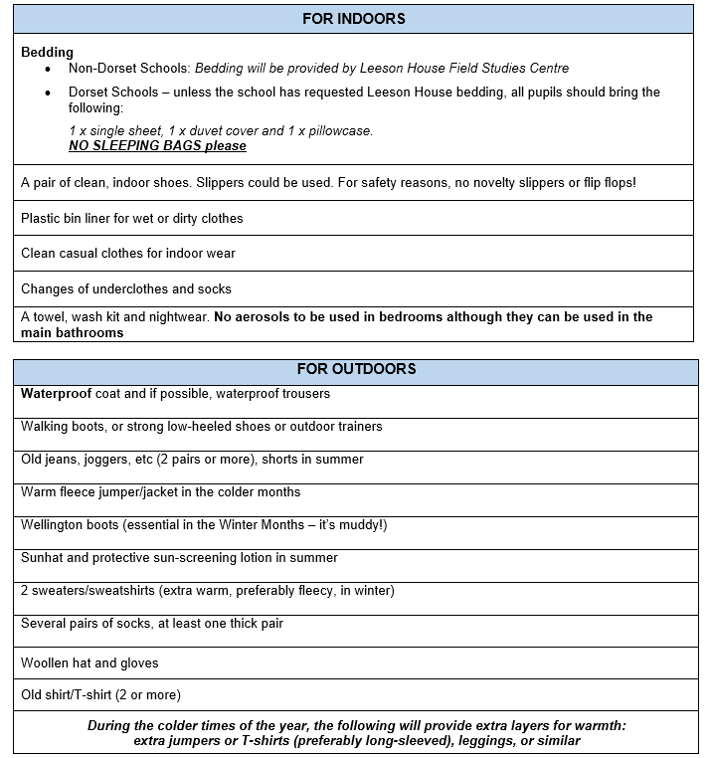
What to bring
Please name EVERYTHING and do not bring any electronics. A simple watch is allowed (not one that can access the internet at all or take photos or message etc).
There is a little shop which sells small gifts. Each child may bring a maximum of £5 – please put this in a named envelope or purse/wallet. This should be handed to an adult on arrival at school.
Please ensure your child has a warm waterproof coat and comfortable waterproof footwear.

Slide 11
What to bring
Please name EVERYTHING and do not bring any electronics.
Your child may wish to bring a book, paper and pencils, or small games for the coach journey and for if there is any free time in their rooms at Leeson House.
Anything they bring should be named and is their own responsibility.

Slide 12
Any questions?
If you think of anything later, please feel free to email us.
office@smsjwool.dorset.sch.uk
s.lyndley@smsjwool.dorset.sch.uk

